Slide 1
Chapter 1
Introducing React

Slide 2
Objectives
Old-School Multipage Design
New-School Single-Page Apps
Meet React
Automatic UI State Management
Lightning-Fast DOM Manipulation
APIs to Create Truly Composable UIs
Visuals Defined Entirely in JavaScript
Just the V in an MVC Architecture

Slide 3
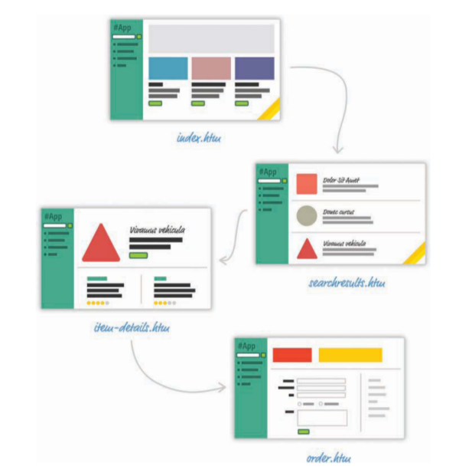
Old-School Multipage Design
For almost every action that changes what the browser displays, the web app navigates you to a whole different page. This is a big deal, beyond just the less-than-stellar user experience users will see as pages get torn down and redrawn.

Slide 4

New-School Single-Page Apps
Instead, modern apps tend to adhere to what is known as a single-page app (SPA) model. This model gives you a world in which you never navigate to different pages or ever even reload a page.

Slide 5
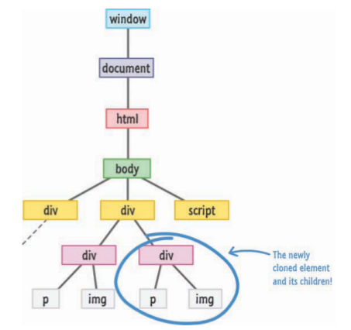
New-School Single-Page Apps
Thanks to a lot of great improvements in both JavaScript and a variety of third-party frame-works and libraries, building single-page apps has never been easier.
1. In a single-page application, you’ll spend the bulk of your time keeping your data insync with your UI.
2. Manipulating the DOM is really, really slow
3. Working with HTML templates can be a pain.

Slide 6

Meet React
Facebook (and Instagram) decided that enough is enough. Given their huge experience with single-page apps, they released a library called React to not only address these shortcomings, but also change how we think about building single-page apps.

Slide 7
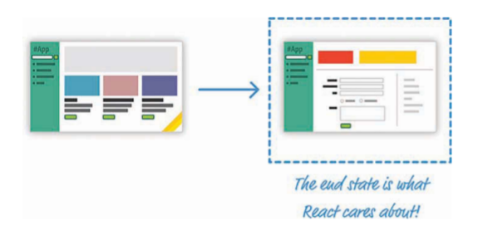
Automatic UI State Management
With React, you need to worry about only one thing: the final state of your UI. It doesn’t matter what state your UI started out in. It doesn’t matter what series of steps your users took to change the UI.

Slide 8
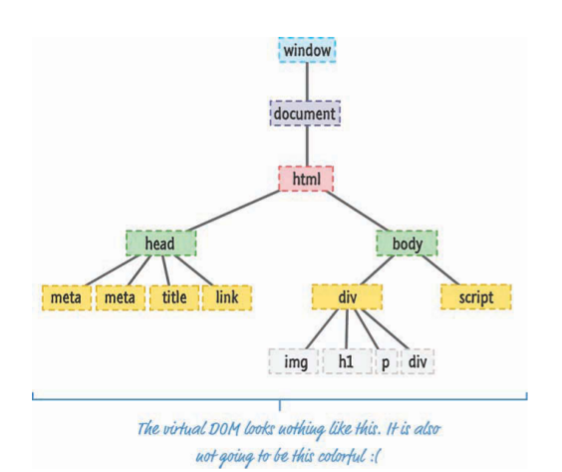
Lightning-Fast DOM Manipulation
Because DOM modifications are really slow, you never modify the DOM directly using React. Instead, you modify an in-memory virtual DOM

Slide 9
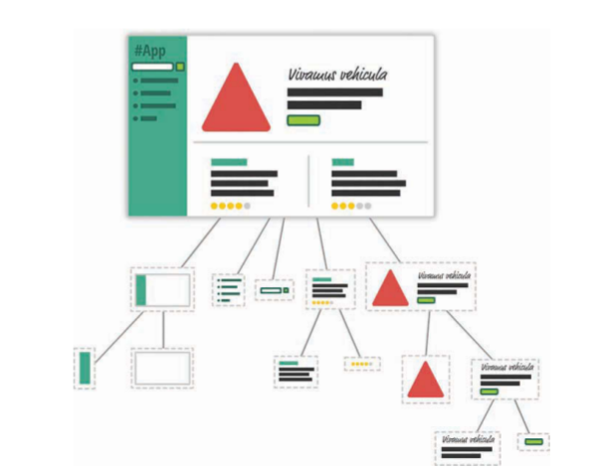
APIs to Create Truly Composable UIs
Instead of treating the visual elements in your app as one monolithic chunk, React encourages you to break your visual elements into smaller and smaller components

Slide 10
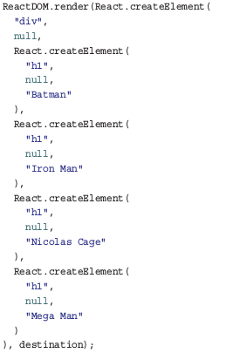
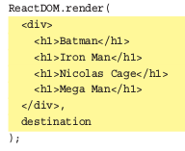

Visuals Defined Entirely in JavaScript
React does something pretty neat. By having your UI defined entirely in JavaScript, you get to use all the rich functionality JavaScript provides for doing all sorts of things inside your templates. You are limited only by what JavaScript supports, not limitations imposed by your templating framework.

Slide 11
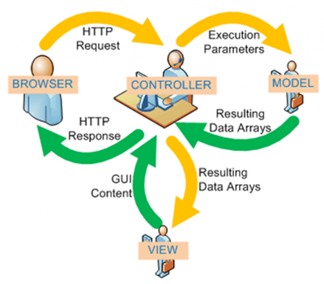
Just the V in an MVC Architecture
React works primarily in the View layer, where all of its worries and concerns revolve around keeping your visual elements up-to-date.

Slide 12
Conclusion
As new web frameworks and libraries go, React is a runaway success. It not only deals with the most common problems developers face when building single-page apps, but it also throws in a few additional tricks that make building the visuals for your single-page apps much easier. Since it came out in 2013, React has also steadily found its way into popular web sites and apps that you probably use. Besides Facebook and Instagram, some notable ones include the BBC, Khan Academy, PayPal, Reddit, The New York Times, and Yahoo!, among many others.

